Slide 1
CRIME + NFL
Team CAKI
(Chad, Alec, Karl, Iris)

Slide 2
WHY NFL & CRIMES?
FOOTBALL has been TOP OF MIND: PLAYOFFS & SUPER Bowl
FOUND RICH DATASET ABOUT NFL PLAYER ARRESTS OVER THE LAST 20 years and wanted to explore
DATA Exploration
WHERE ARE THE CRIMES HAPPENING?
WHICH POSITIONS ARE COMMITING CRIMES?
WHAT KIND OF CRIMES ARE BEING COMMITED?
CRIME OVER TIME?
WHAT IS THE CORRELATION BETWEEN TEAM PERFORMANCE AND TEAM CRIME RATE?

Slide 3
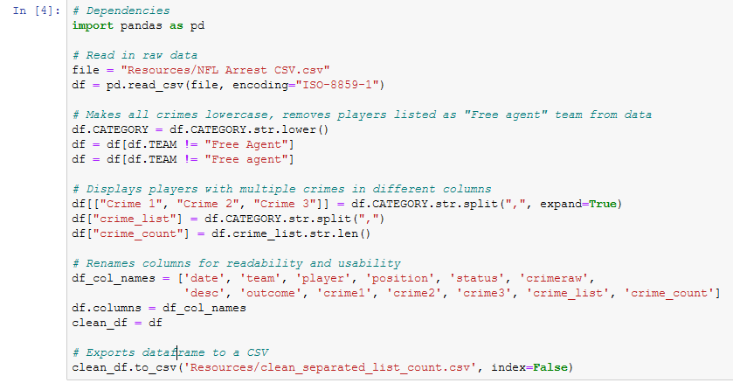
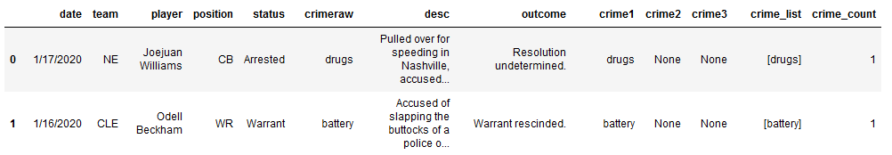
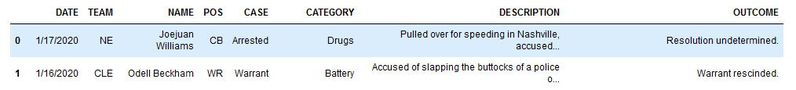
QUICK CLEAN

Slide 4
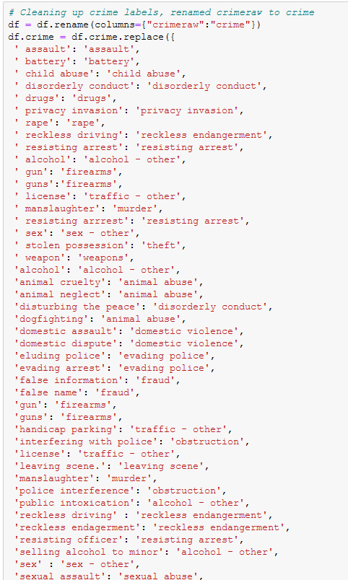
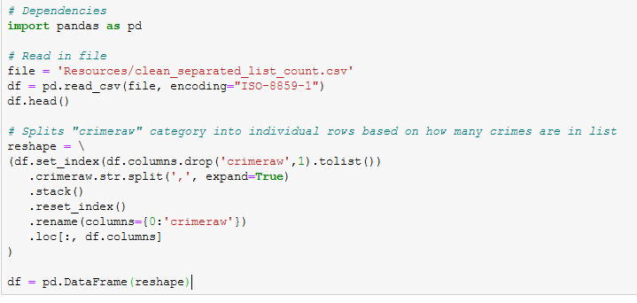
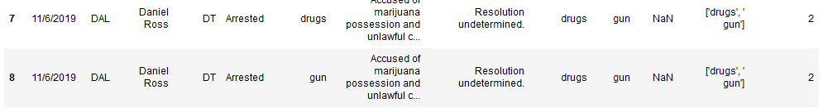
NEW ROW AFTER COMMA

Slide 5
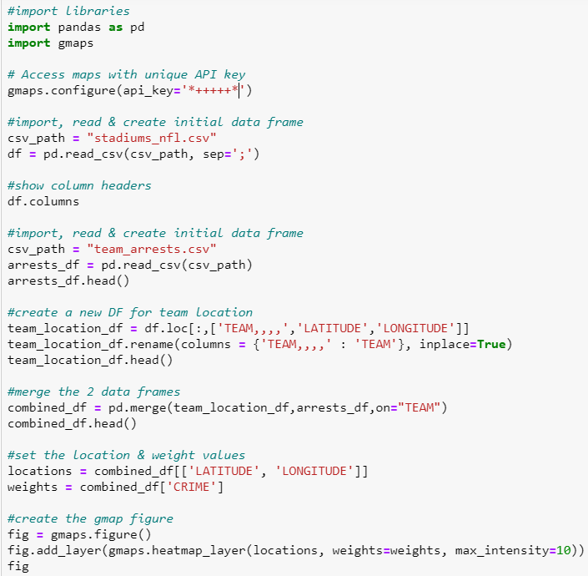
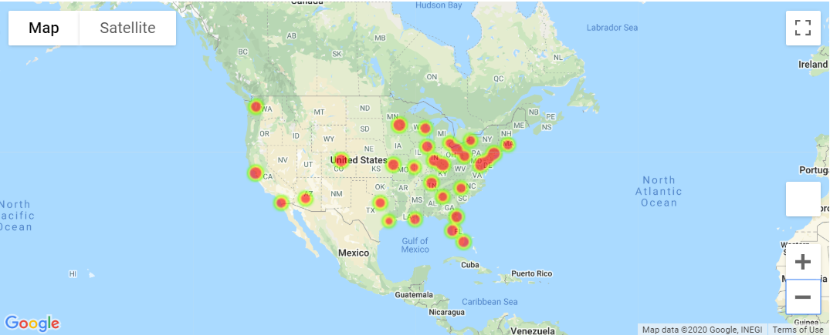
HEAT MAP: TOTAL CRIMES BY TEAM
CODE
VISUALIZATION
ANALYSIS
THE EAST COAST HAS THE MAJORITY OF THE CRIMES
MINNISOTA VIKINGS HAD THE MOST CRIMES OF ANY TEAM
HOUSTON TEXANS HAD THE FEWEST CRIMES OF ANY TEAM

Slide 6
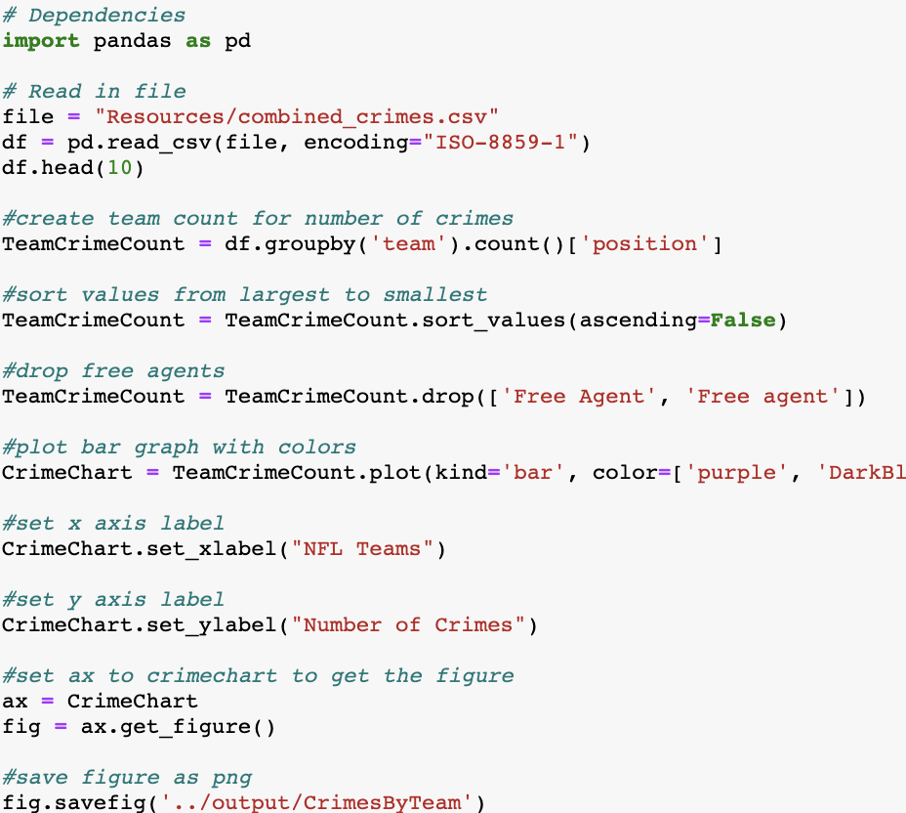
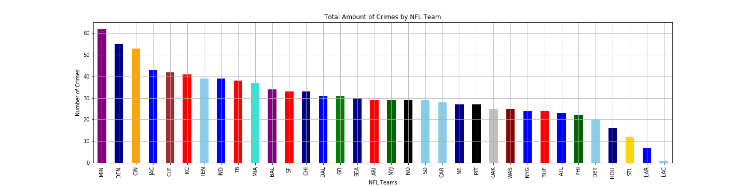
Total Number of Crimes Committed by Each NFL Team 2000-2020
CODE
VISUALIZATION
ANALYSIS
MOST TEAMS BETWEEN 40 – 20 TOTAL CRIMES (1-2 CRIMES PER TEAM PER YEAR)
MIN, DEN, CIN HAVE COMMITED THE MOST CRIMES
LAR AND LAC MOVED TO LA IN 2016 AND 2017, RESPECTIVELY

Slide 7
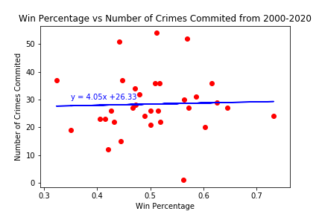
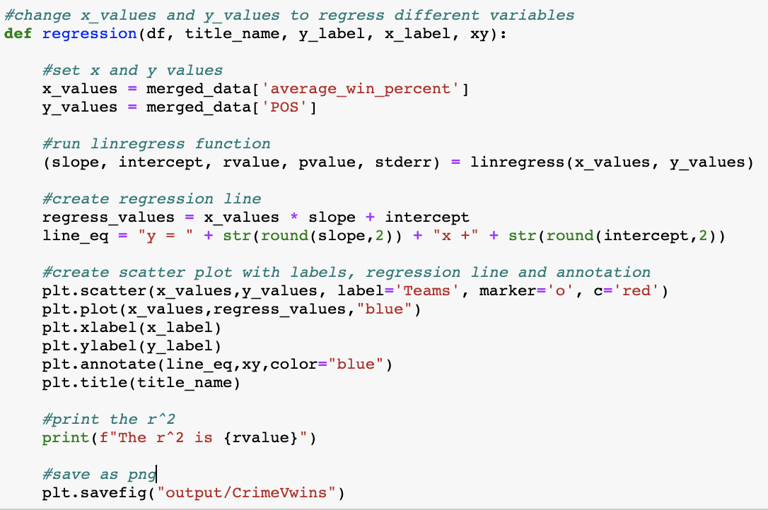
Scatter Plot and Regression of Team Win Percentage on Number of Crimes Committed
CODE
VISUALIZATION
ANALYSIS
THE r^2 IS 0.0325, NO SIGNIFICANT CORRELATION
SAFE TO SAY CRIME HAS LITTLE TO NO IMPACT ON A TEAMS WIN PERCENTAGE

Slide 8
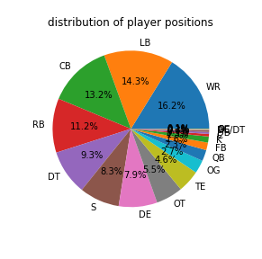
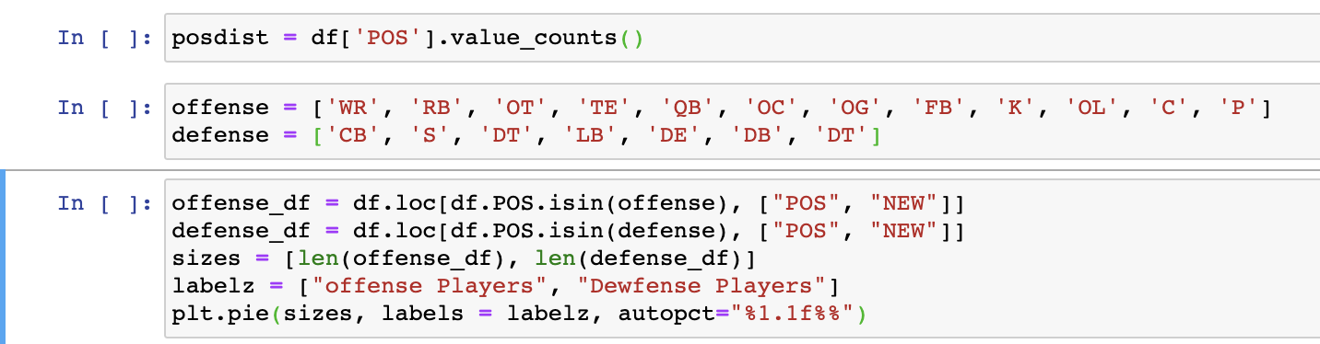
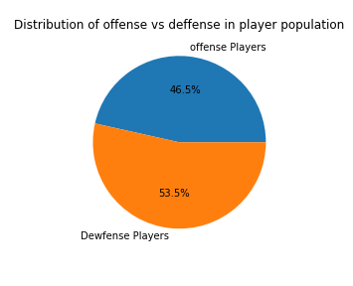
PLAYER POSITION DISTRIBUTION
KNOWING THE DISRIBUTION OF POSITIONS WITHIN OUR DATA GIVES SOME CONTEXT FOR NUMBER OF CRIMES COMMITED PER POSITION
NOTE: IF A PLAYER COMMITED MORE THAN ONE CRIME, THEY REPRESENT MORE THAN ONE DATA POINT AND ARE COUNTED MORE THAN ONCE

Slide 9
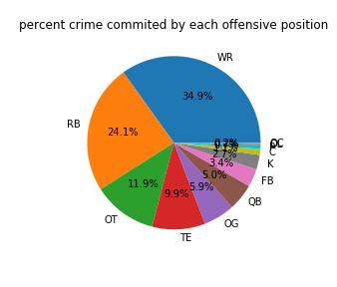
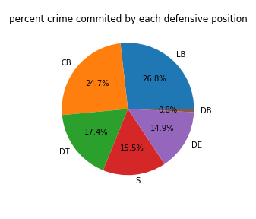
NUMBER OF CRIMES BY POSITION
GIVES CONTEXT ABOUT THE “WHO” FOR THINGS LIKE NUMBER OF CRIMES COMMITED IN A GIVEN YEAR OR CRIME TYPE CATEGORY

Slide 10
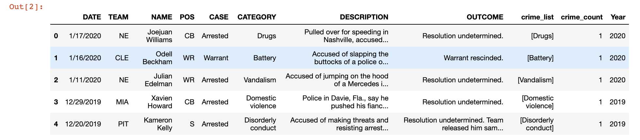
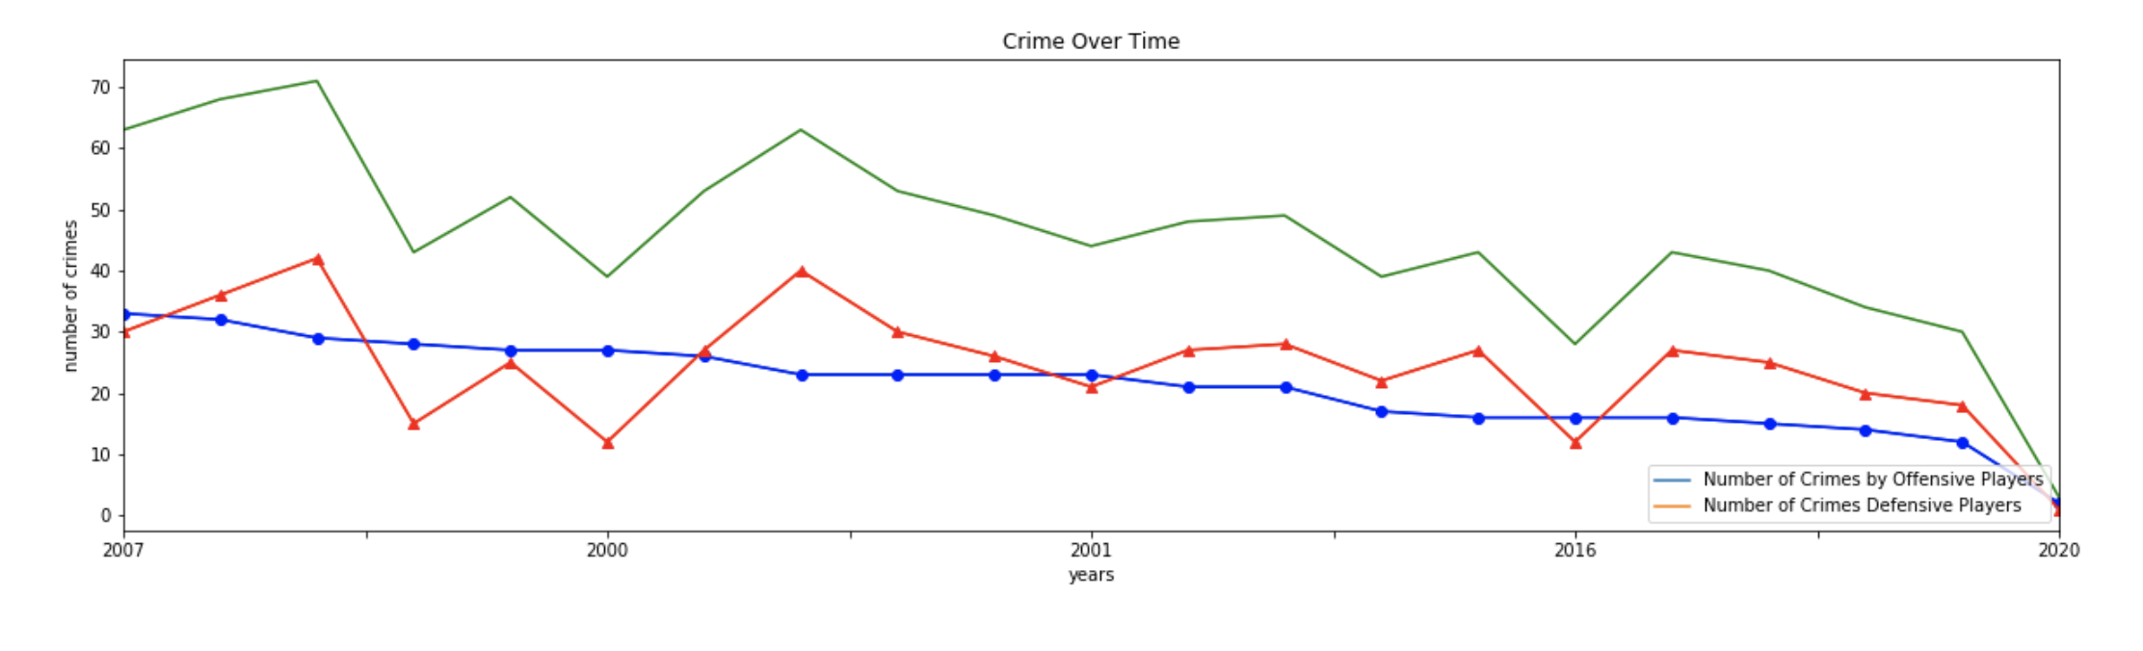
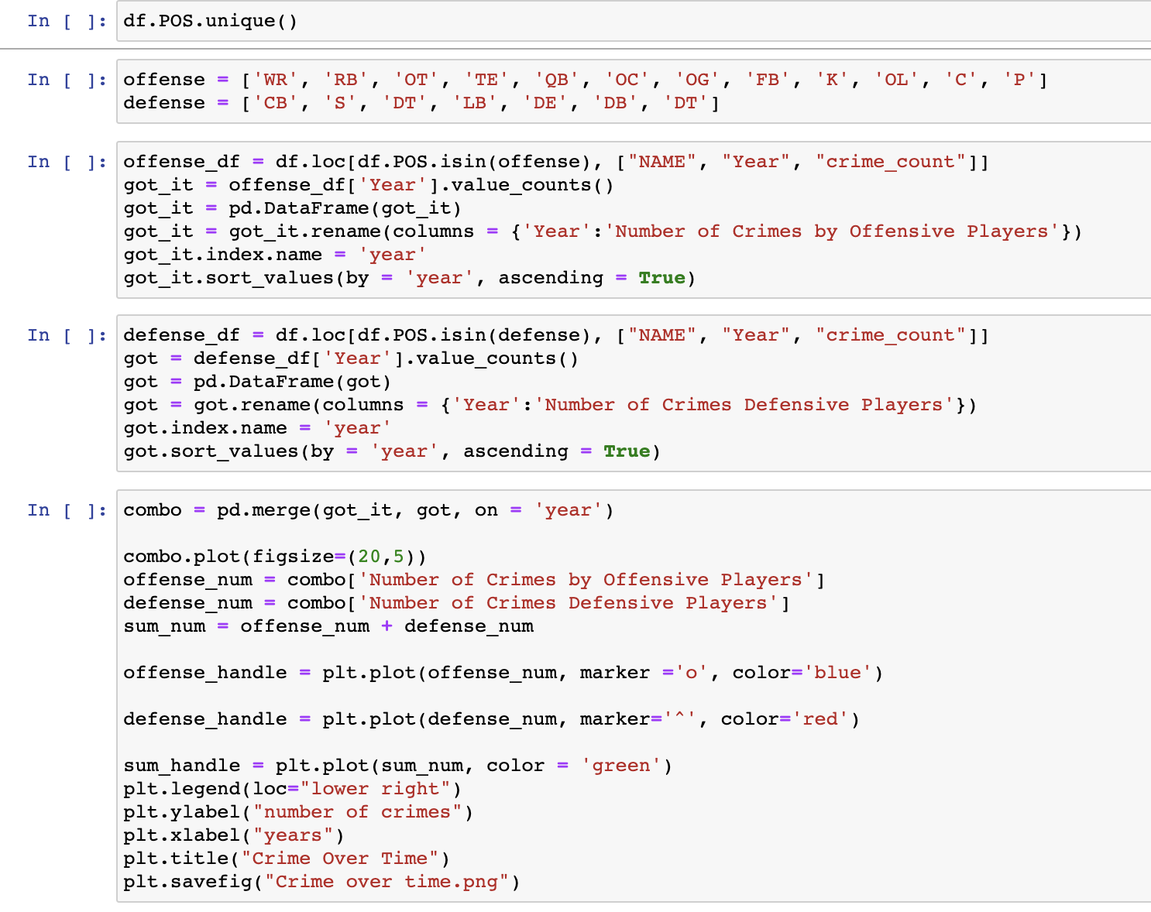
CRIME OVER TIME
Takeaways:
For 13 out of 21 years, offensive players committed more crimes than defensive players
The number total number of crimes committed per year has decreased
The max crimes per year was 71 crimes in 2006

Slide 11
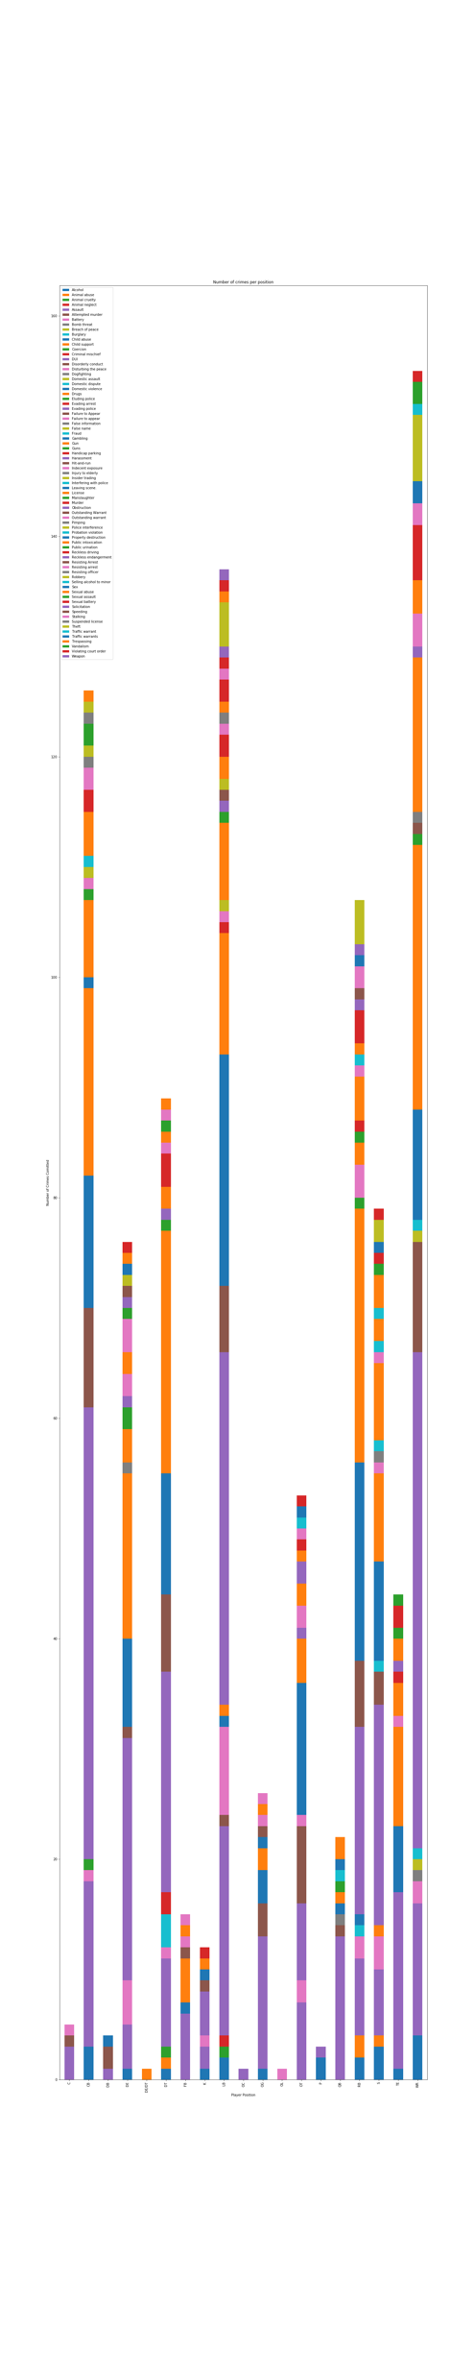
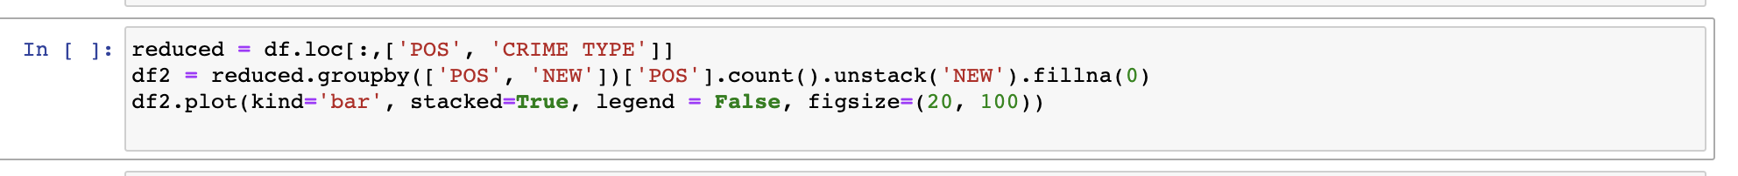
POSITION vs CRIME TYPE
Takeaways:
In each stacked bar, distribution of crime type looks roughly similar.
Wide receivers committed the most crimes in total.

Slide 12
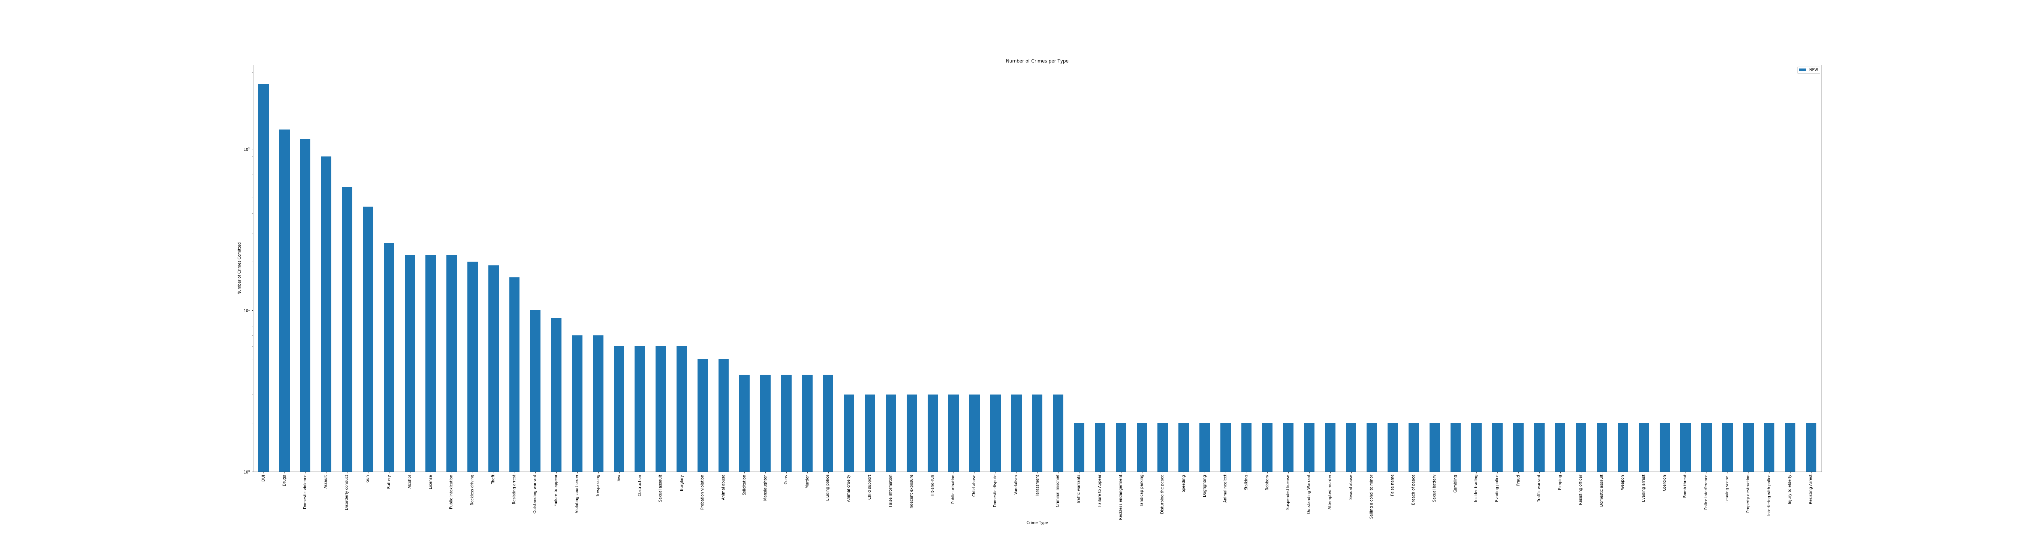
CRIME TYPE TOTALS
df[‘Crime type’].value_counts()
DUI’s are the most frequently committed crime

Slide 13
ISSUES & PAIN POINTS
CONTEXT WITH LANGUAGE IN THE DATA
COMBING DATA FRAMES & MERGING ADDITIONAL DATA
DATA MUNGING
SIMPLY CRIME TYPES CATEGORIES
COMPARE CITY CRIME RATE vs TEAM CRIME RATE

Slide 14
THANK YOU FOR LISTENING!
FROM TEAM
CAKI

